Slide 1
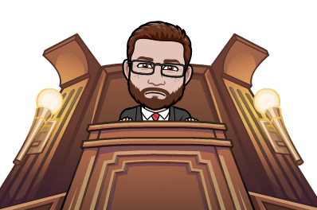
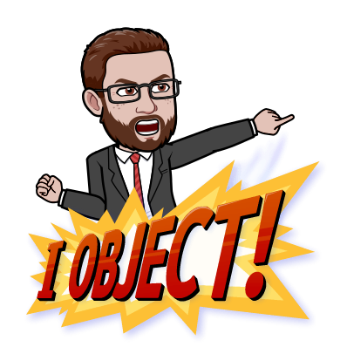
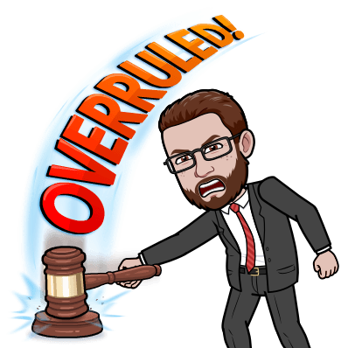
Mock Trials

Slide 2
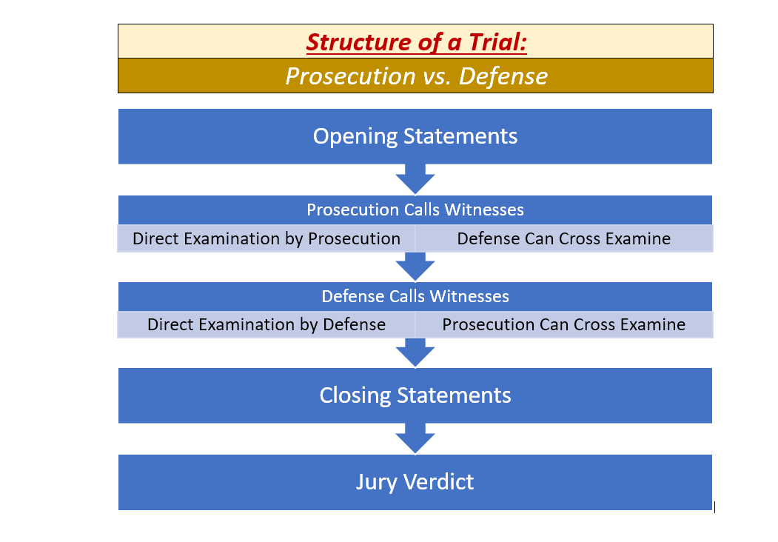
Structure of a Trial

Slide 3
Case 1: STATE v. TONY
Question: Did Tony throw the stone that broke Mr. Wiley’s windows?
Crime: Vandalism
Whoever intentionally causes damage to physical property of another without his or her consent is guilty of misdemeanor and will be sentenced to imprisonment for not more than 90 days or payment of a fine of not more than $1,000 or both.

Slide 4
Case 1: STATE v. TONY
Prosecution:
Lawyer: Julissa
Mr. Wiley: Adilen
Leslie: Ezequiel
Researcher: Sherlyn
Defense:
Lawyers: Joseph & Stefany
Tony: Cole
Sandy: Nicholas

Slide 5
Case 1: STATE v. TONY
Question: Did Tony throw the stone that broke Mr. Wiley’s windows?
Crime: Vandalism
Whoever intentionally causes damage to physical property of another without his or her consent is guilty of misdemeanor and will be sentenced to imprisonment for not more than 90 days or payment of a fine of not more than $1,000 or both.

